Slide 1
Employee Management System
Java
https://github.com/Ciprian1922/Code_Works/tree/main/P3/Employee_Management_System
Popa Ioan-Ciprian

Slide 2
Motivation
Easy to use employee management system with interactive GUI and variety of options to adopt it for your own taste.

Slide 3
01
Files
02
GUI reading
File not found (automatically creates “emp.txt”)
Every wrong input is being managed with a try-catch error mechanism, and no employee with wrong input data will be added in the table
03
Console reading
Exception handling
Same as the GUI, reading an employee from console is also being handled with a custom try-catch mechanism for every single field(ID, Name, Age, Function, Married, Region)

Slide 4
01
“dev”
02
“load”
Using this argument allows the user to remove employees
The program uses only the employees from “emp.txt” in order to work and it automatically saves the progress after the program is closed.
03
Both “dev” and “load”
They can be used simultaneously
Arguments

Slide 5
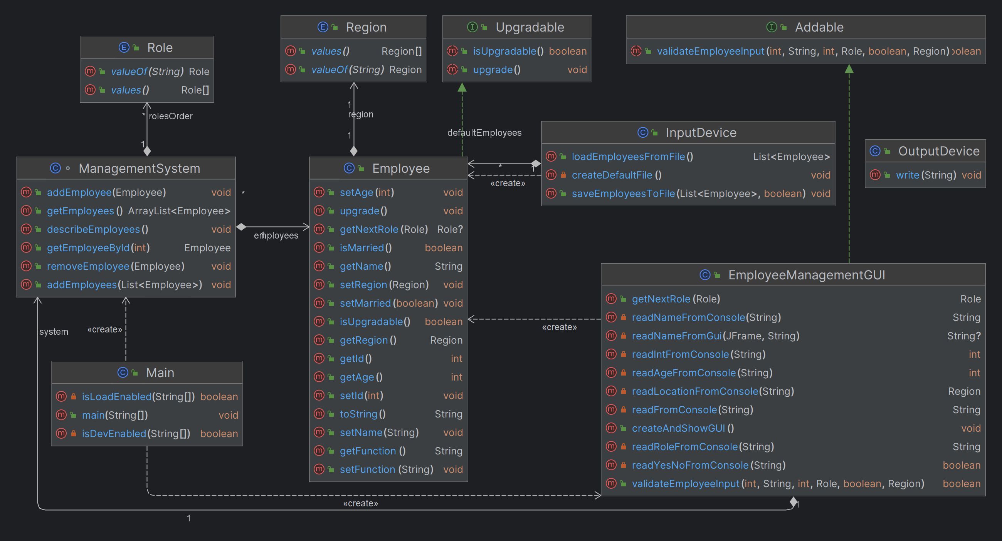
Diagram

Slide 6
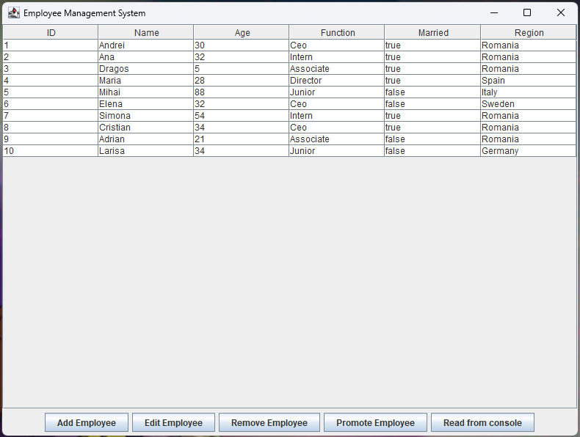
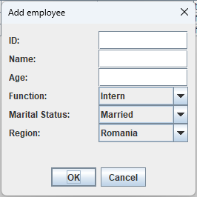
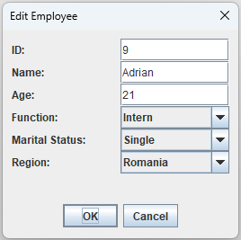
GUI
Promote selected employee

Slide 7
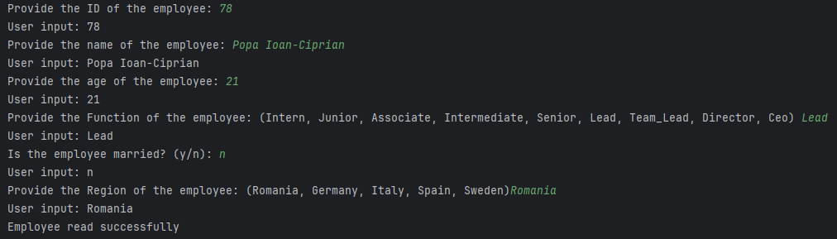
Reading from console

Slide 8
END OF
PRESENTATION
Thank you for paying attention!

